Slide 1

3）Vibration Frequency (ν)
K-strength constant of chemical bond; m-reduced mass of chemical group
ν ∝ (groups with same atoms)
e.g.：
Group K/N·cm⁻¹ ν(σ /cm⁻¹)
C ≡ C 12～18 2262～2100
C＝C 8～12 1600～1680
C－C 4～6 1000～1300

Slide 2
ν ~ m⁻²
Group m ν(σ /cm⁻¹)
C－H 0.9 2800~3100
C－C 6 ~ 1000
C－Cl 7.3 ~ 625
C－I 8.9 ~ 500

Slide 3
4）Division of Molecular IR spectrum
Region | Frequency | Groups and Vibration
Single bonds to hydrogen | 4000～2500cm⁻¹ | O－H、C－H、N－H Stretching Vibration
Triple and cumulated double bonds | 2500~2000cm⁻¹ | C≡C、C≡N、N≡N、C＝C＝C、C＝C＝O Stretching Vibration
Double bonds | 2000~1500cm⁻¹ | C=O、C=C、C=N、NO₂、phenyl Stretching Vibration
Single bonds (fingerprint) | 1500~400cm⁻¹ | C－C、C－O、C－N、C－X Stretching Vibration O－H、C－H、N－H Bending Vibration
: Characteristic; Functional Group determination
: Fingerprint, for standard spectrum comparision

Slide 4
5）Factors affecting the IR frequency
Electron effect
Stereo effect
Hydrogen Bond

Slide 5
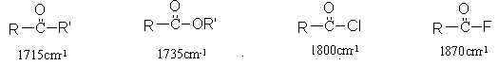
Electron Effect
a. Induction Effect:
More electronegative, higher frequency.
e.g. ν_{C＝O}

Slide 6
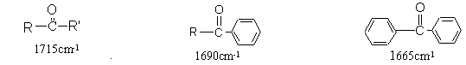
b. Conjugation Effect:
For double bond: More conjugation, lower frequency.
For single bond: More conjugation, higher frequency.
e.g. ν_{C＝O}

Slide 7
For double bonds, the induction effect and conjugation effect are counterproductive. So, in groups which have both these two effects, how to decide the frequency shift?
Principle:
For those conjugation effect is larger than induction effect: red shift.
For those conjugation effect is less than induction effect: blue shift.
ν_{C＝O} = 1690 cm⁻¹
ν_{C＝O} = 1735 cm⁻¹

Slide 8
Stereo-effect
a. Steric hindrance
Break the planarity of the conjugation，weaken the
conjugation effect, cause higher frequency shift.
1663cm⁻¹ 1686cm⁻¹ 1693cm⁻¹

Slide 9
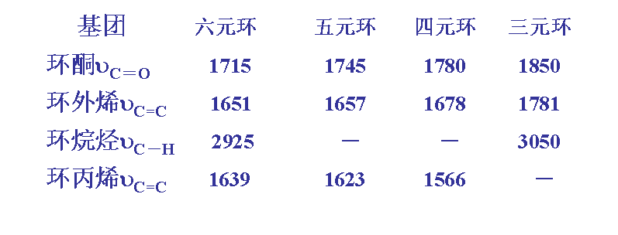
b. Ring strain
Higher ring strain, higher frequency for exocyclic groups, lower frequency for endo-cyclic groups.

Slide 10
Hydrogen bond
Lower Frequency
Broaden Peak
Higher Intensity
Often seen in:
Alcohols (-OH)
Phenols (-OH)
Carboxylic acids (-COOH).

Slide 11
For example, in carboxylic acids:
The hydrogen bonds here not only shift –OH to lower frequency with broader peaks, but also shift –C=O to lower frequency.

Slide 12
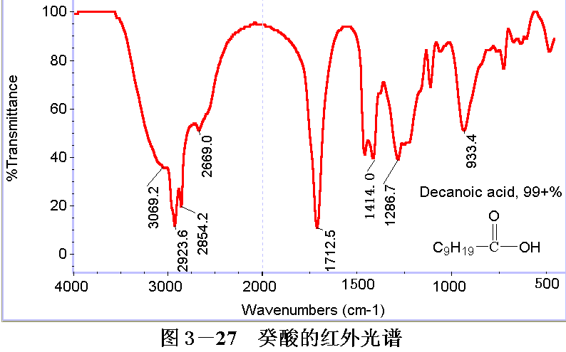
Decanoic acid
A broadened peak at 3069.2 cm⁻¹ is dedicated to –OH in COOH, and a sharp peak at 1712.5 cm⁻¹ is for –C=O in COOH, which is red shifted compared to original –C=O (around 1760 cm⁻¹).
Notes:
hi

Slide 13
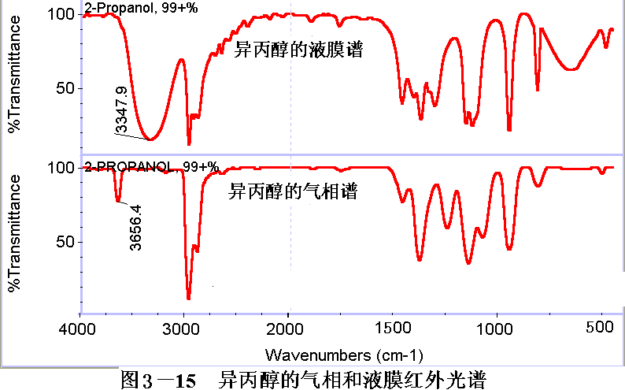
In pure liquid alcohol or in polar solvents, the –OH peak is broadened and enhanced due to hydrogen bond formation (above).
In gas phase or non-polar solvents, the isolated –OH peak is sharper but much weaker (below).

Slide 14
6）Factors affecting the IR intensity
Intensity
∝
Δμ
Molecular Dipoles：More polar, higher intensity
Molecular symmetry：More symmetric, lower intensity
e.g. R－CH＝CH₂ ε = 40
（least symmetric）
cis R－CH＝CH－R´ ε = 10
（medium symmetric）
trans R－CH＝CH－R´ ε = 2
（most symmetric）
（ε =molar extinction coefficient）

